Slide 1



Unlimited Energy Possibility
Raymond Tan
Founder
ray.tan@raitan.sg

Slide 2





Strategy
Net Zero by 2050
30% of the demand
2GWp
3% of the demand
Import Clean Energy
Increase PV
Phase out ICE by 2040
200MWh
Cleaner Energy Vehicle
Energy Storage System
Notes:
Increasing take up rate for EV = Stress in Grid

Slide 3




HURDlES
Net Zero by 2050
Import Clean Energy
Increase PV
Energy Security
Intermittency
Energy can be cut off due to natural or man-made disaster
PV are weather dependent.
Surge in demand & Availability
Space & Safety
With more EV, electricity demand will increase exponentially. Charger availability will be a problem
ESS take up huge space and are fire hazard
Cleaner Energy Vehicle
Energy Storage System
Notes:
Increasing take up rate for EV = Stress in Grid

Slide 4


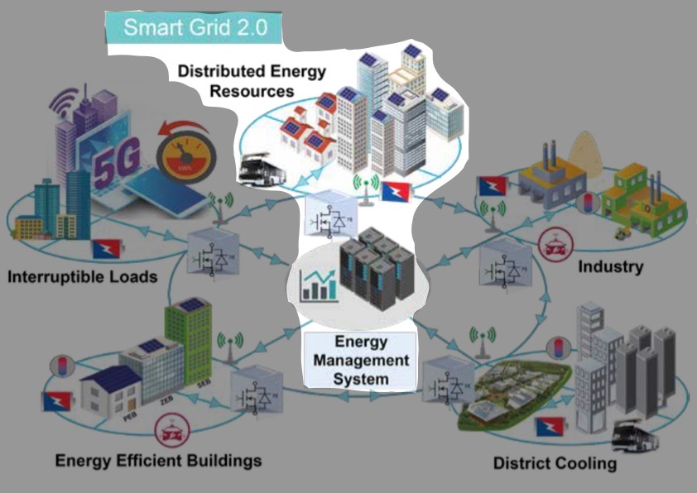
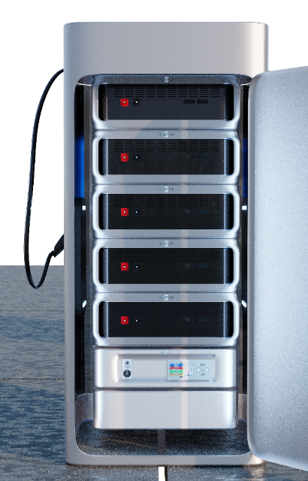
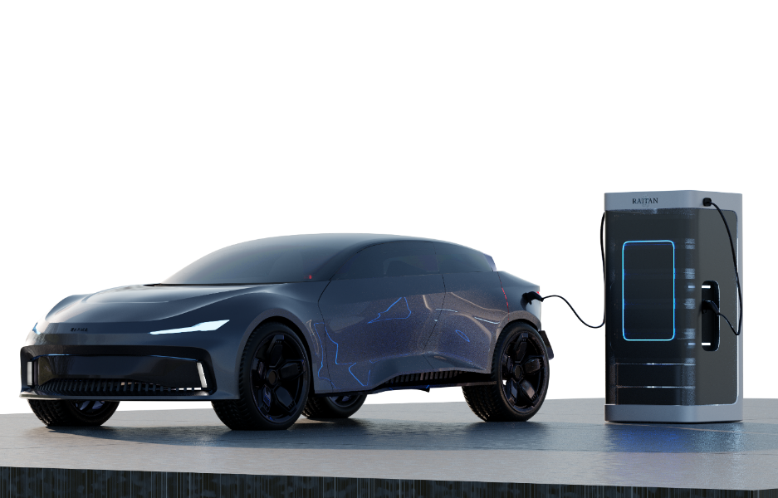
Solution
Intermittency
Energy Security
Surge in Demand
Availability
Space
Safety
The solution to these problems is distributed energy storage system in smart grid 2.0.
RAITAN believes that an integrated ESS with EV charger is suitable for Singapore.
DERs
Smart Grid 2.0
Mugen EV Charger

Slide 5


How ESS helps
Intermittency
Energy Security
Surge in Demand
+
To solve the above problem, we can store renewable energy in ESS, and coupled with Energy Management Systems, we can optimize the output of the ESS to the grid. With a stable grid, renewable energy will more readily acceptable to the public.
Notes:
Store clean energy and with energy management system distribute evenly to maintain the grid frequency and generators output.

Slide 6

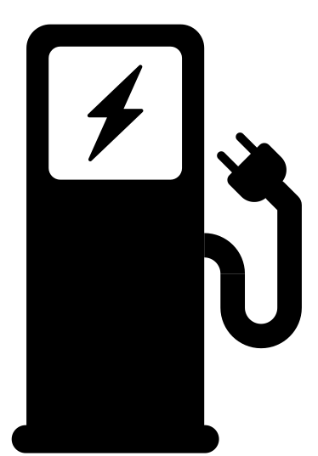
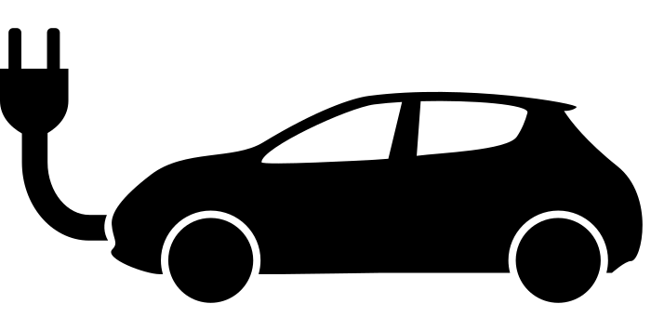
How ESS helps
Availability
ESS Microgrid
+
=
=
=
Existing carparks have limited available power, which limits the number of EV chargers in Singapore. With ESS microgrid, we can boost the available power in the carparks and we can increase the number of chargers which will indirectly increase the take-up rate of EV.

Slide 7
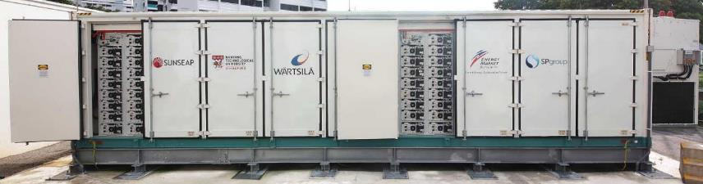
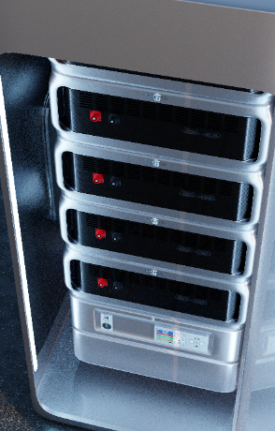


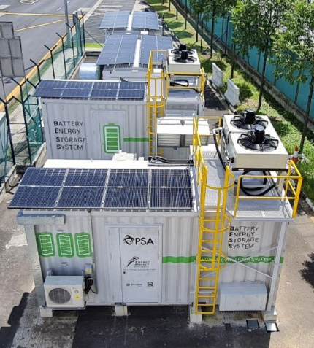
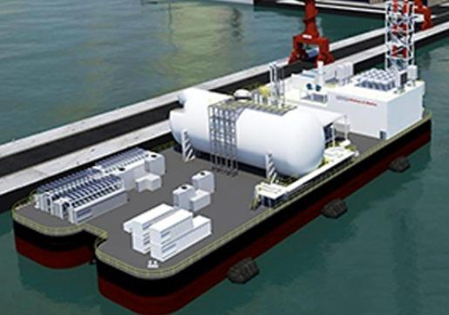
How ESS helps
Space
Distributed ESS
Centralised ESS
Existing ESS are mostly centralized ESS which is huge and far away from the heartland. This is not suitable for a city-state like Singapore as we have limited spaces. Distributed ESS are more suitable where we can utilize the limited spaces and place it near the demands. This also improves the efficiency as lower energy is loss through the transmission line.

Slide 8

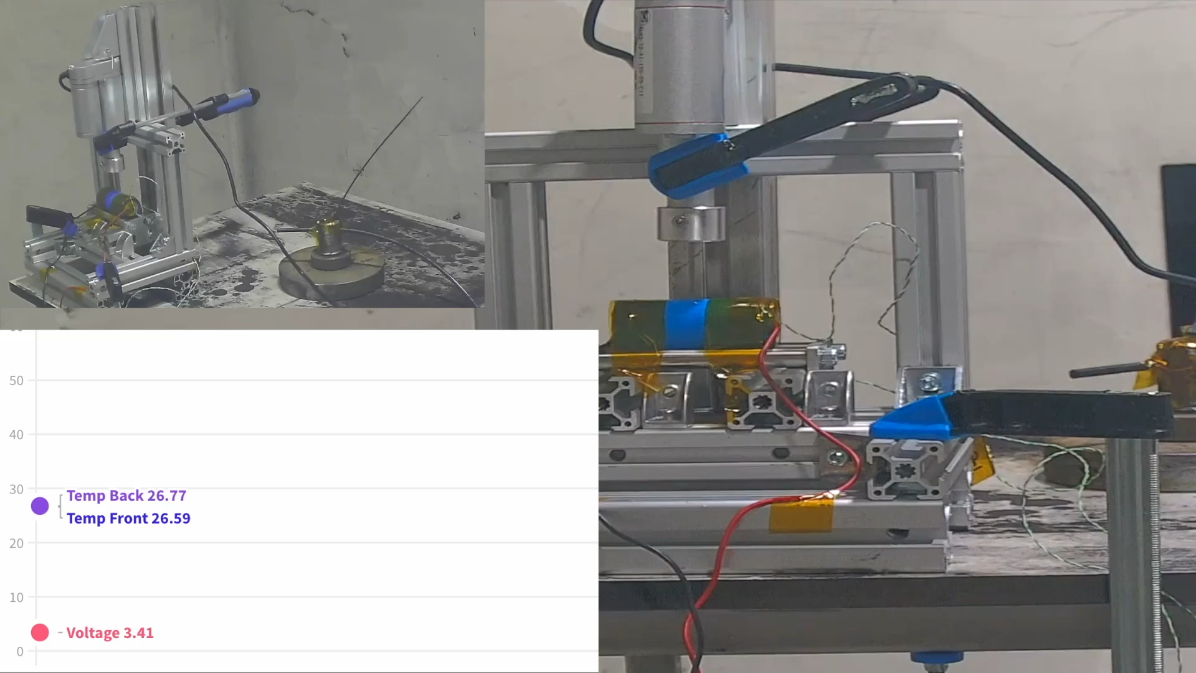
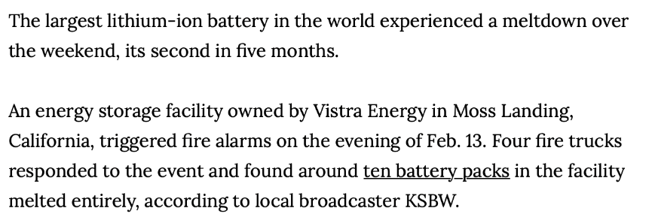



How ESS helps
Safety
LG Batteries fire on 13 Feb 22, at Moss Landing California
Nail Penetration Test
ESS can be a fire hazard if it is not handled properly. There are multiple cases of ESS fire overseas, due to a single-cell breakdown, which leads to fire propagation within the battery system. At RAITAN we do nail penetration tests to force the cell to go into an internal short circuit to make sure that the cell that we use will not be the fire source in the event the cell separator breakdown.
Tesla batteries on fire in July 2021 at Neoen's Victorian Big Battery project in Australia

Slide 9
Summary
ESS speeds up the greenification of our future grid
City-centered ESS is essential to meet the net-zero target

Slide 10
Q&A

