Slide 1
ADVANCING R&D IN INTEGRATED MODELLING AND SIMULATION OF FUTURE ENERGY SYSTEMS
Muhamad Azfar Ramli, Ph.D.
Deputy Department Director, Systems Science
Institute of High Performance Computing, A*STAR
Singapore International Energy Week (SIEW) 2022

Slide 2
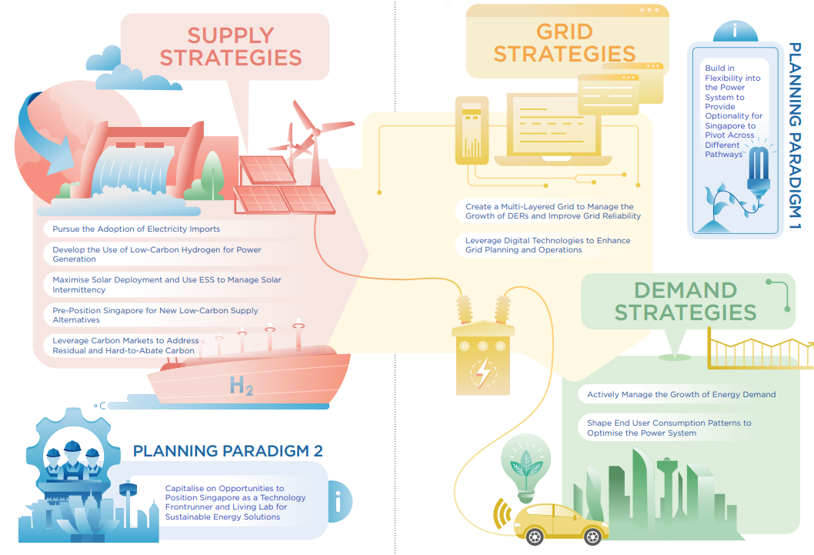
Recommendations from Energy 2050 Committee Report
https://www.ema.gov.sg/energy-2050-committee-report.aspx
A data-driven approach for modelling and simulation of these emergent multi-energy systems (aligned to the above strategies and paradigms) would therefore be essential in helping both public and private sector organization understand and evaluate scenario pathways leading towards net zero targets.

Slide 3


Co-innovation through Deep Multidisciplinary Modelling, Simulation and Knowledge-driven AI
Complex
Multi-scale Urban Systems Modelling
Social & Human Behaviour
Modelling
Physics-Based Modelling, Engineering Systems
Systems Science
Social & Cognitive Computing
Engineering Mechanics
Materials Science
& Chemistry
Fluid Dynamics
Electronics & Photonics
Complex Systems
Multi-scale Optimisation
Energy Systems
Affective and Social Intelligence
Cognitive & Decision Science
Social & Behaviour Inference
Human Centric Intelligence
Collaborative Intelligence
Analysis, Design & Optimisation
Advanced Methods Development
Materials Processing & Mechanics
Soft Materials & Hybrid Systems
Mechanics of Nano-structures
Alloys & Materials Design
Chemistry & Catalysts
Polymers & Formulations
Electronics & Semiconductors
Coupled & Complex Flow
Physics-based Data Driven Modelling
Engineering Fluids Flow
Computational Design & Optimisation
Electromagnetics
3D Inverse Imaging & Optical Modelling
Nano & Quantum Photonics/AI
Advanced & Efficient Computing & AI
Computing & Intelligence
Computational Artificial Intelligence
High Performance Computing
Decentralised Computing
High Performance AI Platform Programme
Cross-departmental Initiatives
Knowledge-driven AI
Digital Manufacturing Processes & Design
Accelerated Materials & Chemicals Development
Green Technologies for Marine, Offshore, Oil & Gas Engineering
Environmental & Food Sustainability
MedTech &
HealthTech
Quantum Computing

Slide 4



Systems Science Department @IHPC
COMPLEX SYSTEMS
MULTI-SCALE OPTIMIZATION
ENERGY SYSTEMS
Develop and apply systematic and analytical approaches to design, optimize and enhance decision-making for planning and operations of large-scale complex urban systems.
Agent-based Simulations
Complex Network Analysis
Systems
Optimization
Maritime
& Port Operations Simulation
Logistics & Process Modelling
Decision Support
Systems
Power Flow
& Grid Optimization
Infrastructure Planning
Renewable & Distributed Energy Resources
Model the dynamics and predict emergent behaviour of highly interacting systems through data-driven complexity science to gain insights into urban systems and evaluate impact of decision making for different scenarios.
Improve operational efficiency of port operation and analyse sea traffic dynamics to detect collision risk and carry out proactive management for maritime traffic safety.
Performing integrated multi-energy systems modelling and simulation for infrastructure planning, risk and resilience assessment and policy impact analysis.

Slide 5





Energy Systems Group Key Capabilities
Power Flow Analysis & Optimization
e.g. peak load management, volt-var optimization, feeder reconfiguration
+
Infrastructure Planning & Policy Analysis
Renewables & Distributed Energy Resources
e.g., network configuration, resilience assessment, optimal siting
e.g. electric vehicles, on-site solar PV, energy storage systems
Modelling, simulation, and optimization of integrated multi-energy systems, for infrastructure planning and policy analysis, to incorporate emerging energy resources and improve efficiency and resilience.

Slide 6










Multi-Energy System Modelling & Optimization (MESMO)
MESMO is an open-source software library for modelling, simulation and optimization of multi-scale electric and thermal distribution networks along with distributed energy resources (DERs).
Electric grid
EV
charging
Traditional
loads
Flexible
loads
Stationary storage
Renewable generators
District
cooling plants
Challenges
Opportunities
Power system simulation​
Electric load flow modelling for unbalanced multiphase networks.​
Thermal grid simulation​
Thermal load flow modelling for district cooling systems.​
DER simulation​
State space modelling of system dynamics and
operational constraints.​
Dispatch optimization​
Optimal multi-energy system operation decisions through convex optimization.​
Developed in collaboration between:

Slide 7
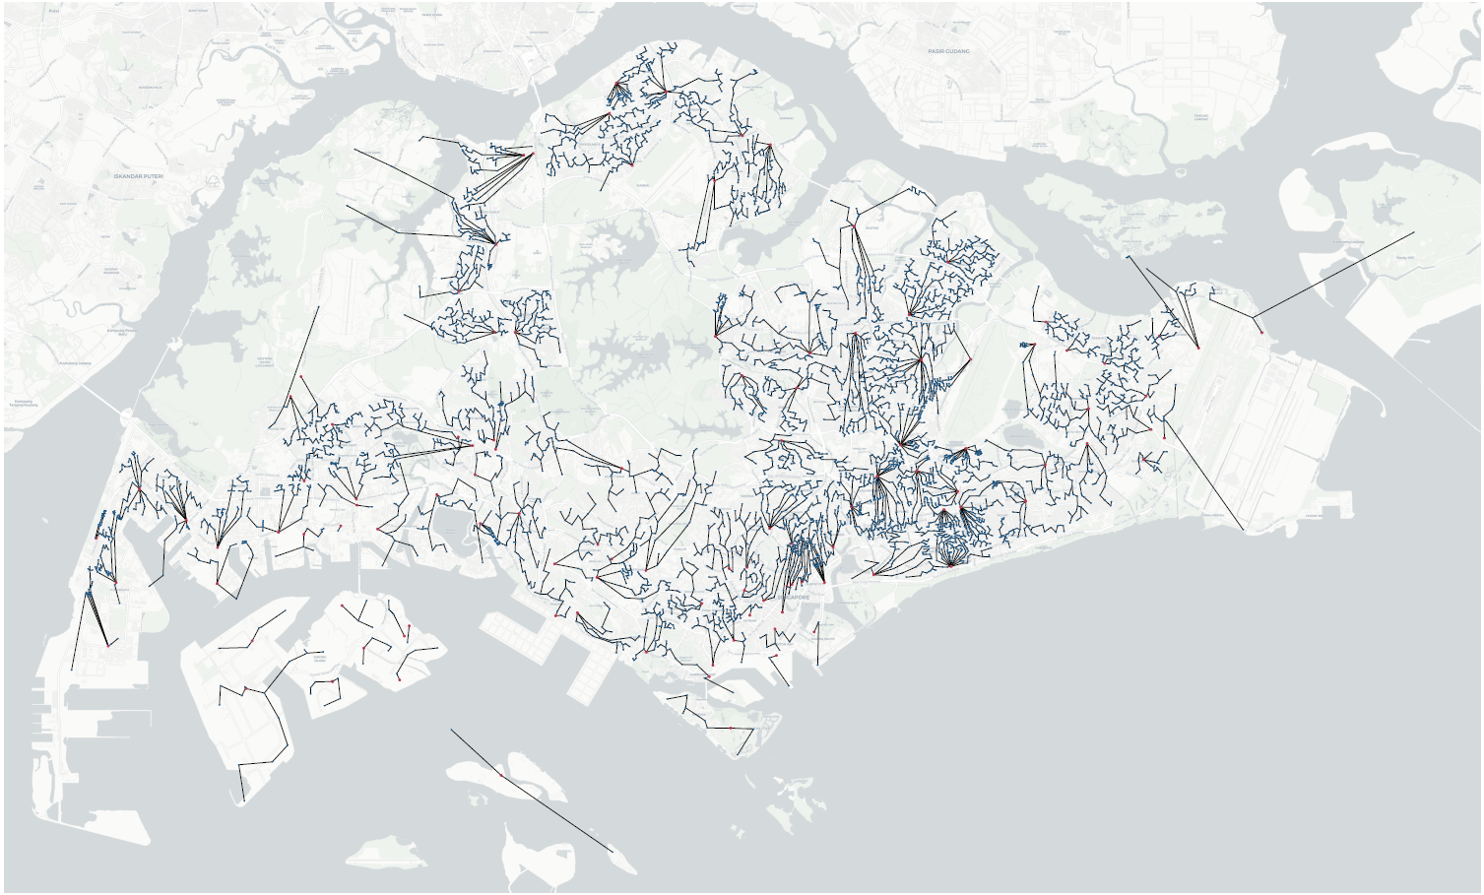



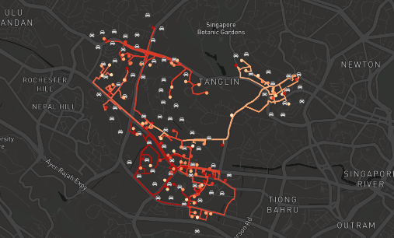
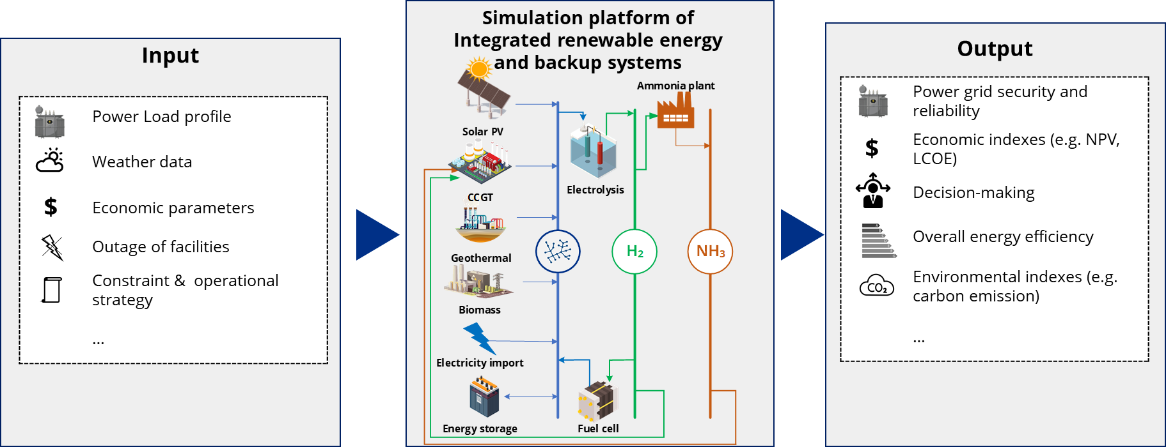
Key Research Topics
Distribution Grid Network Twin
2. Integrated Simulation and Optimization
of Electric Vehicle Charging
Mobility
events
Charging
demand
Middleware
Charging demand model
Scheduling algos
Charging
schedule
Power
limit
Topology & Utilization Data
Network Twin Model
3. Distributed Energy Resource
Control & Optimization
4. Renewable Integration into the Power Grid

Slide 8


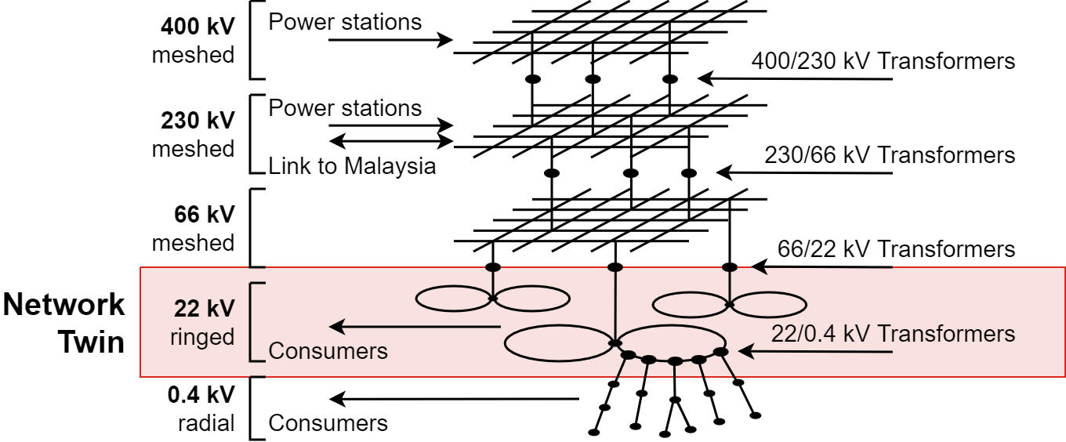
Topic 1 Recap :
Network Twin for Distribution Grid Modelling
In Collaboration with:
Motivations
  Understand interdependencies and trade-offs in the electric distribution system
  Improve design and operations planning of the electric distribution system
  Evaluate distribution system technologies to understand complexity and save on costly field demonstrations
Current Modelling Scope
Use Cases
+
Impact analysis of emergent energy demand
(e.g., electric vehicles)​
Distribution automation
(e.g., volt-var optimization, device coordination, feeder reconfiguration, smart grid technologies)​
Peak load management
(e.g., centralized vs transactive vs distributed solutions)​
Distributed generation and storage
(e.g., on-site solar PV, distributed storage)​
Expansion planning
(e.g., network configuration, optimal siting of generation)​

Slide 9
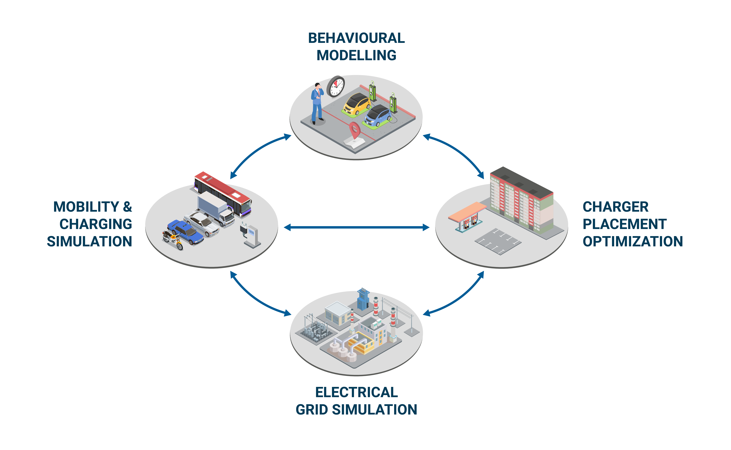
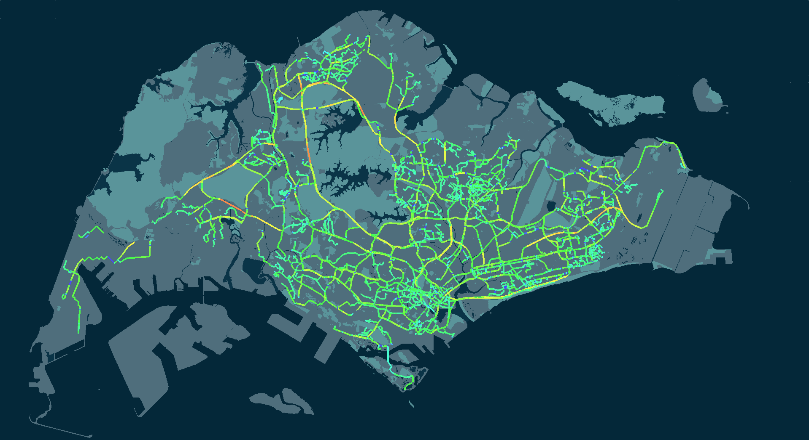


Topic 2 Recap: Project SITEM (Singapore Integrated Transport & Energy Model)
Comprehensive impact analysis and policy recommendation study of vehicle electrification on Singapore’s transport and energy system.
High fidelity modelling and simulation of mobility behaviour and electric grid.
Comparative analysis of multiple scenarios to quantify the impact of different Concepts of Operations (CONOPS).
  Jointly collaboration between:
  Supported by:
High fidelity mobility and charging simulation made possible with City Mobility Simulator (CityMoS) https://citymos.net/

Slide 10

Topic 2: Integrated Simulation and Optimization of Electric Vehicle Charging
Coupling Middleware
Charging Demand Modelling
Charging Schedule Optimization
Optimal
Power Flow
Electric Grid Simulation
Power Flow Modelling
Max Loadability Calculations
Mobility & Charging Simulation
Electric
Vehicle Simulation
Behaviour Modelling
Mobility Events
Charging Demand
Charging Schedule
Grid Utilizations
Enables high fidelity modelling and simulation of a broad spectrum of EV charging concepts of operations
Simple scheduling algorithms (e.g., equal charge, first-in-first-out)
Sophisticated scheduling algorithms that utilize demand predictions and/or real-time grid conditions
Joint optimization and scheduling with other distributed energy resources (DERs)

Slide 11






Topic 3: Distributed Energy Resource (DER) Control & Optimization
Substation
1. Solar to
Load
3. ESS to Load
Reverse
Power Flow
2. Solar to
ESS
4. Charge ESS from Grid
Scheduling of multiple DERs (e.g., flexible loads such as EV charging, PV, ESS) to reduce energy cost and peak demand as well as mitigate impact on upstream network
Analyzing impact of size of DERs (e.g., number of charging points, PV capacity, ESS capacity) on demand including analysis of ESS degradation
Network level co-optimization for energy aggregator scenario analysis

Slide 12
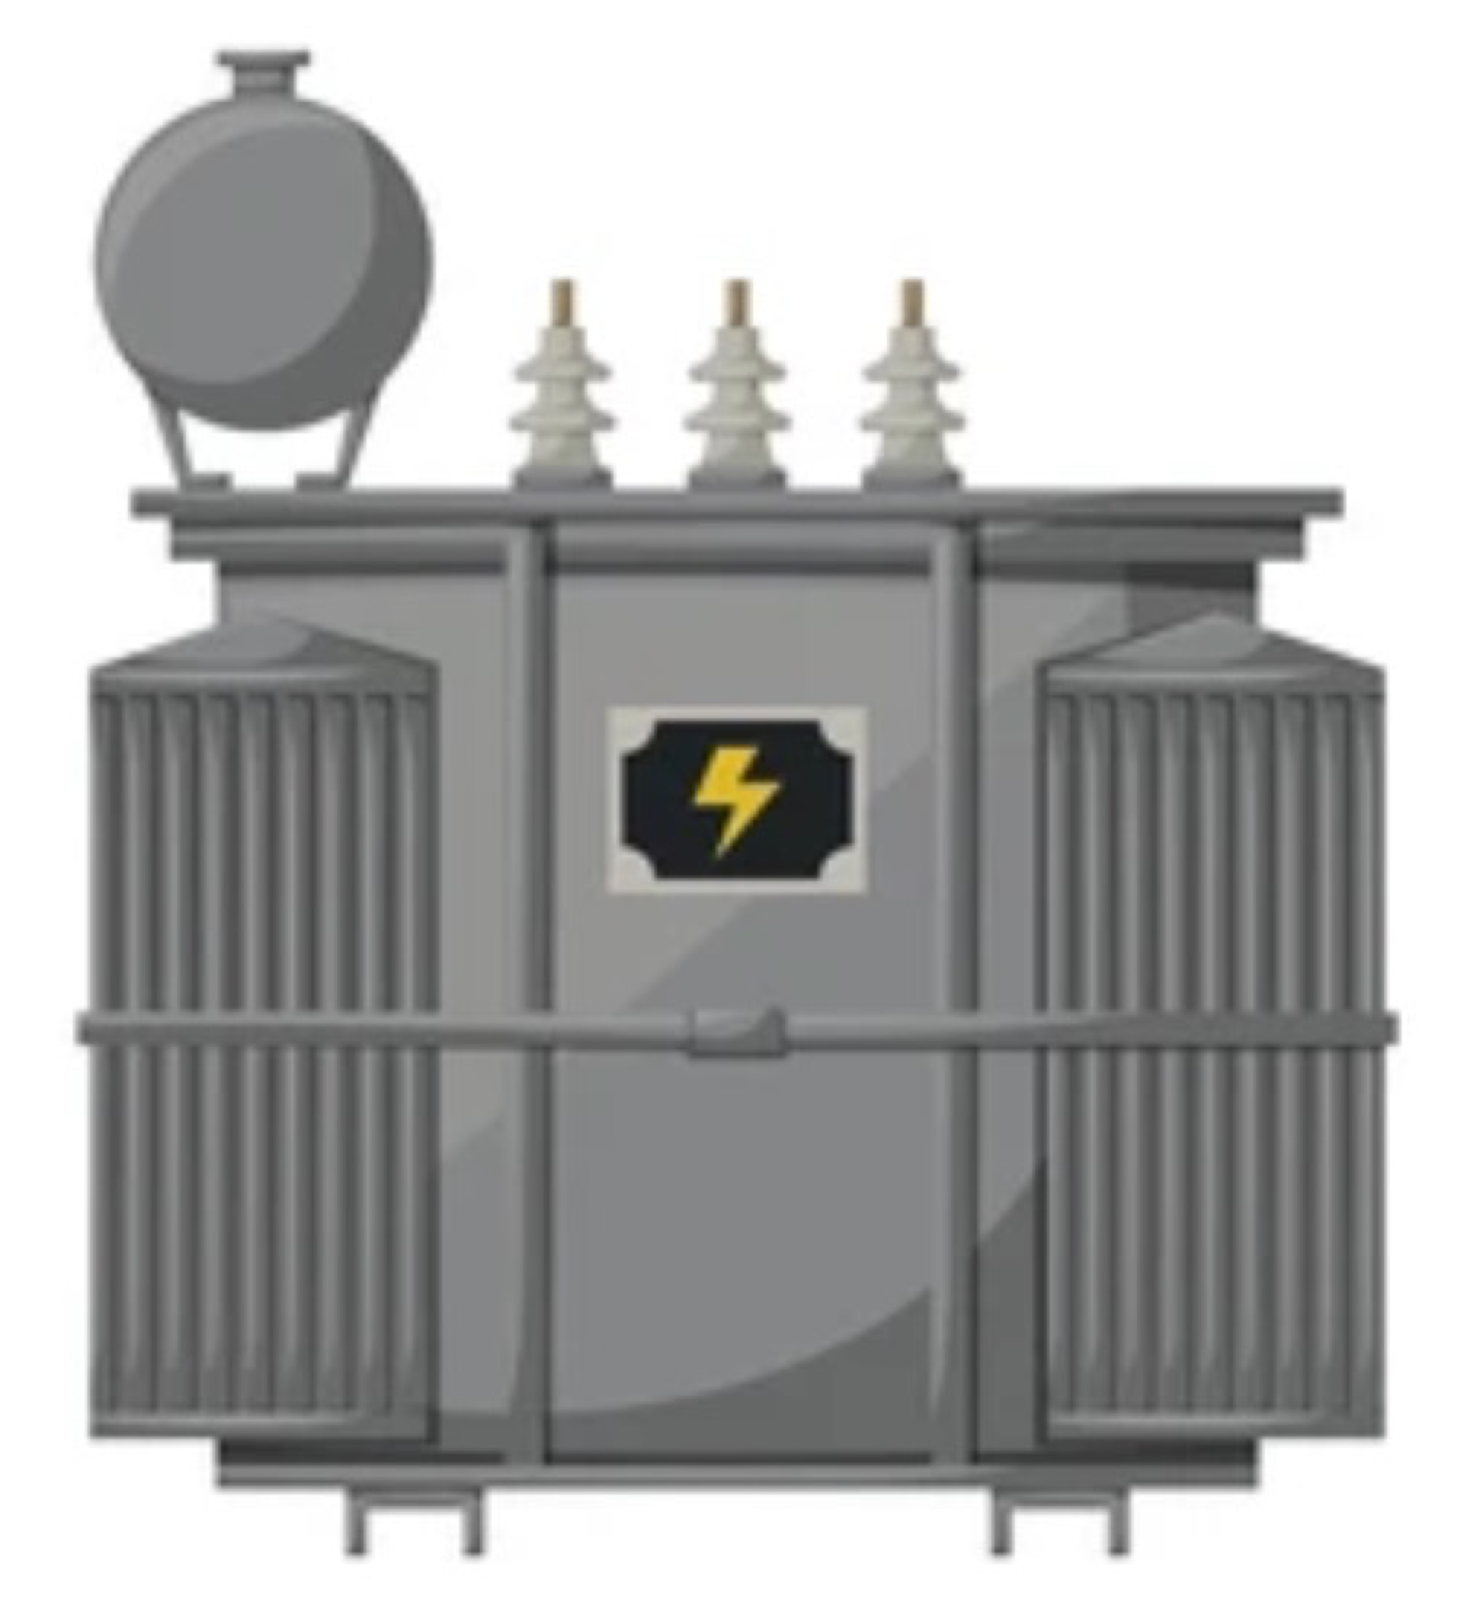


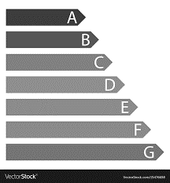

Topic 4: Renewable Integration into the Power Grid
Key Features
Renewable energy resource assessment
Dynamic simulation and optimization of integrated renewable energy and backup systems
Multi-criteria decision-making support tool
Simulation platform of Integrated renewable energy and backup systems
Input
Output
 | Power grid security and reliability
$ | Economic indexes (e.g. NPV, LCOE)
 | Decision-making
 | Overall energy efficiency
 | Environmental indexes (e.g. carbon emission)
 | …
 | Power Load profile
 | Weather data
$ | Economic parameters
 | Outage of facilities
 | Constraint & operational strategy
 | …

Slide 13
Summary of key modelling objectives
Modelling, simulation, and optimization of electric grids to support operations, analysis, and future planning:
Identify risks and inefficiencies in the grid
Rapidly model, simulate, and evaluate alternative technologies and operating mechanisms
Develop optimal grid control mechanisms through stochastic optimization and reinforcement learning
Develop infrastructure upgrade plans through applied optimization and power flow algorithms
An integrated multi-energy system modelling and simulation platform for planning and policy assessment:
Model and simulate interactions between multiple energy resources (e.g. renewable and distributed generation, energy efficiency technologies, demand side management, regional power imports, etc)
Identify risks and inefficiencies in energy system
Rapidly model, simulate, and evaluate benefits and impacts of alternative technologies and policies
Assess environmental impact and techno-economics of alternative business models
Develop technology adoption and infrastructure upgrade plans through applied optimization

