Slide 1
Energy Security trends in Southeast Asia
Sue-Ern Tan, Head of the IEA Regional Cooperation Centre
Singapore, 28 October 2025

Slide 2
Increased ASEAN import requirements through 2030 lead the world
Net product trade, 2024-2030
ASEAN’s increasing product import needs drive broader Asian trade flows. The Middle East and the United States will consolidate position as major product exporters of middle distillates, naphtha and LPG.

Slide 3
Untapped renewable potential in the region with capacity to integrate more
Variable renewable energy (VRE) generation share and integration phase assessment of selected countries, 2024-2030
Most countries in the region can integrate higher VRE share through 2030 by applying proven measures which do not require significant investments

Slide 4
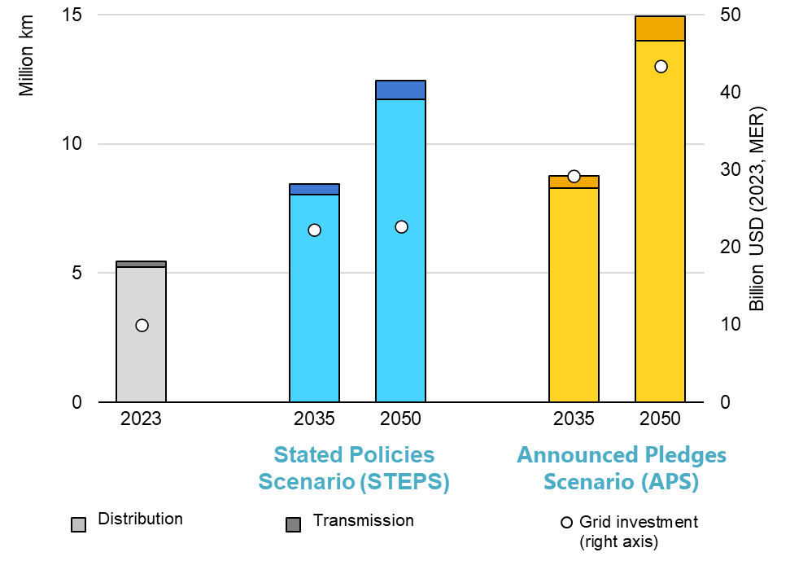
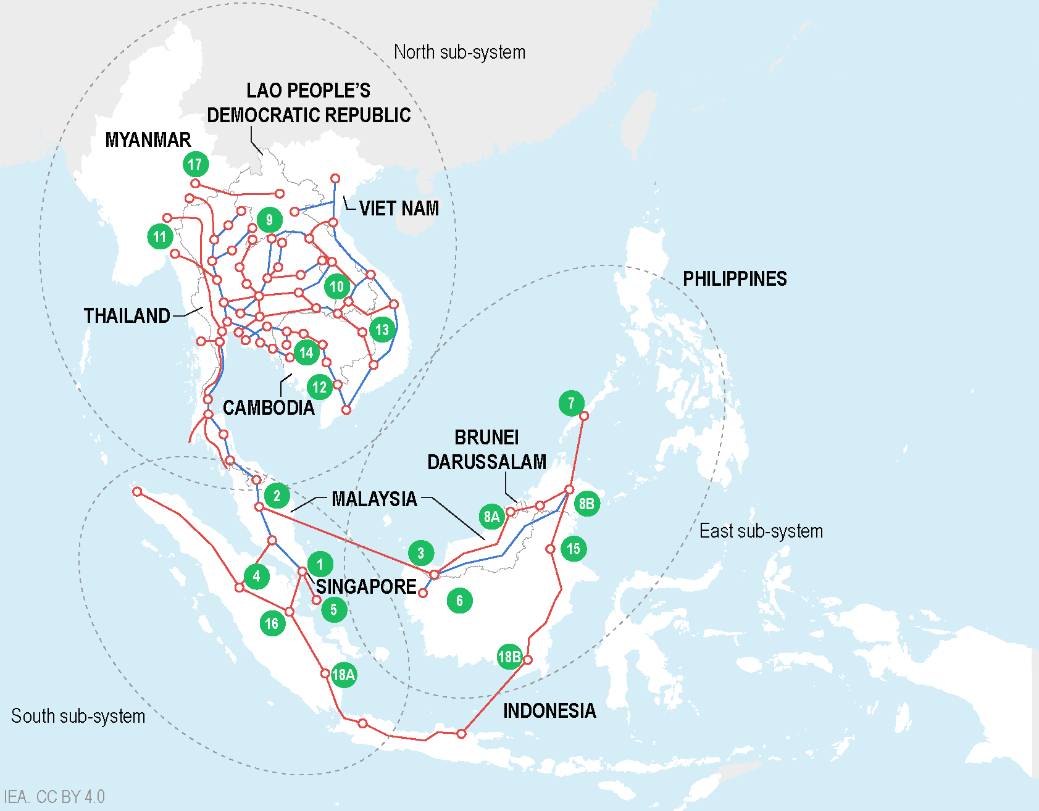
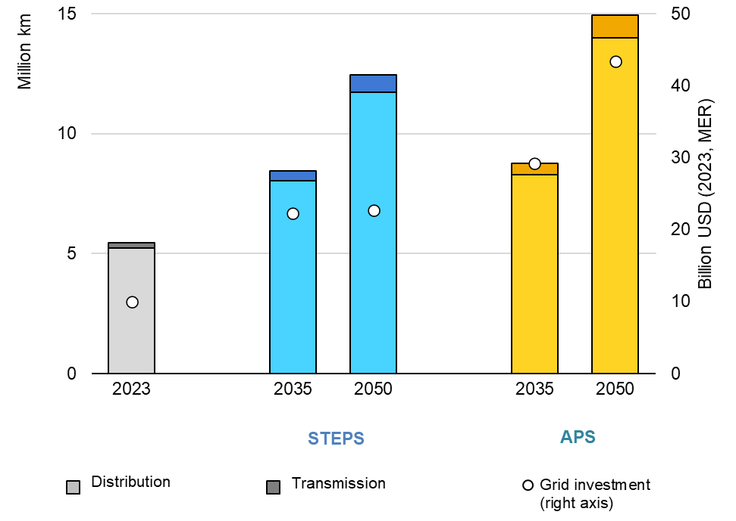
Grid modernisation and expansion is essential
Installed transmission and distribution line length and annual average investment by scenario for SE Asia, 2023-2050
ASEAN Power Grid
WEO – ASEAN
Domestic grid expansion and regional interconnections are key to meeting rising demand for electricity and providing energy security at a country and regional level

Slide 5
Significant expansion of investment is essential for Southeast Asia
Annual energy demand growth
Annual energy investment growth
World
Southeast
Asia
World
Southeast
Asia
World
Southeast
Asia
World
Southeast
Asia
2015 - 25
2025 – 35
2015 - 25
2025 – 35
Southeast Asia’s energy demand has grown at twice the global average over the past decade and will keep rising.
However, investment has fallen behind, and a major scale-up is essential to support the region’s growth.

Slide 6
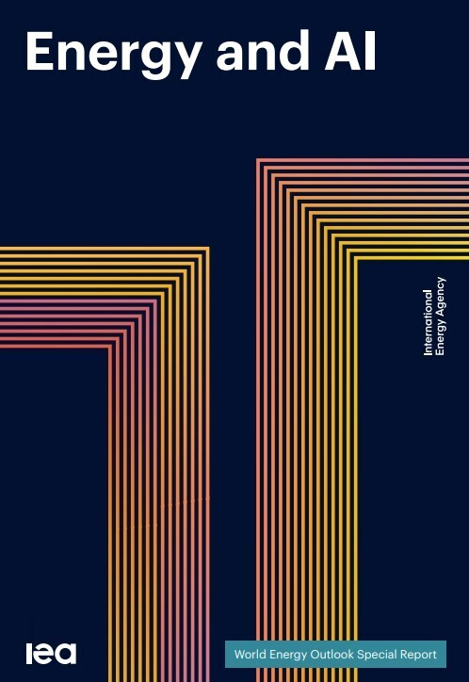
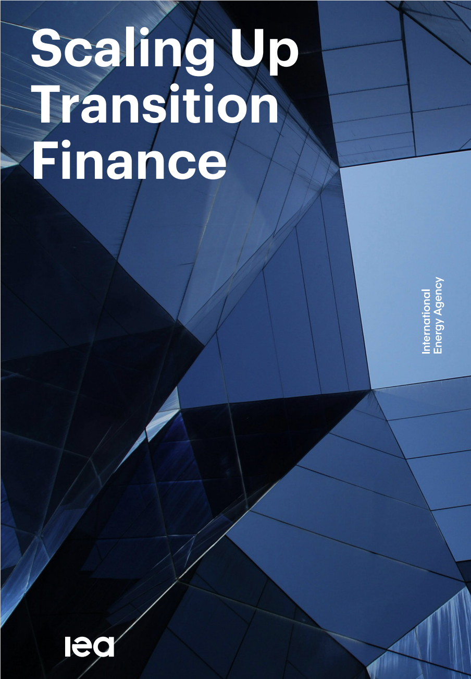
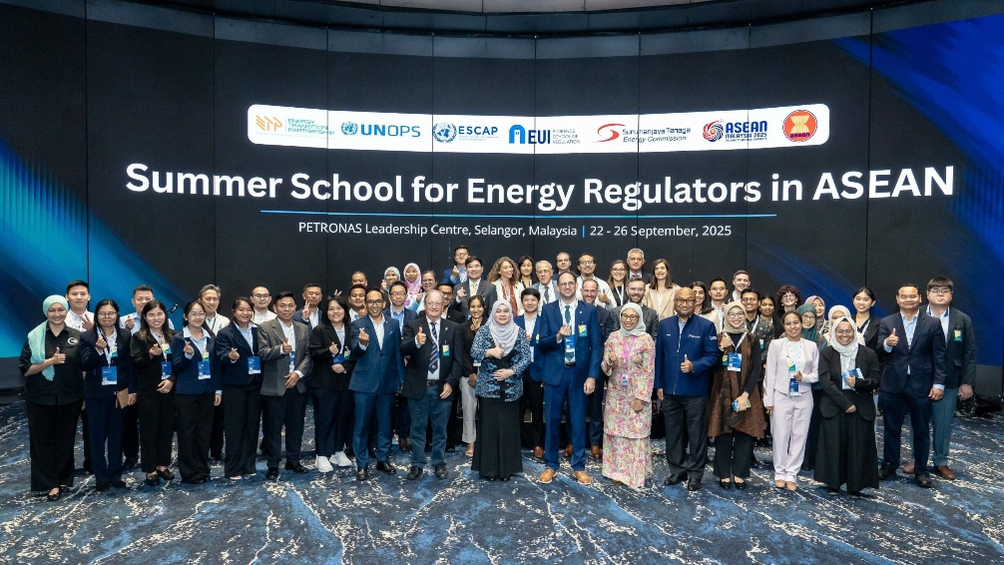
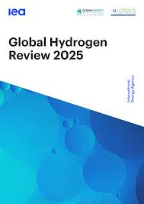
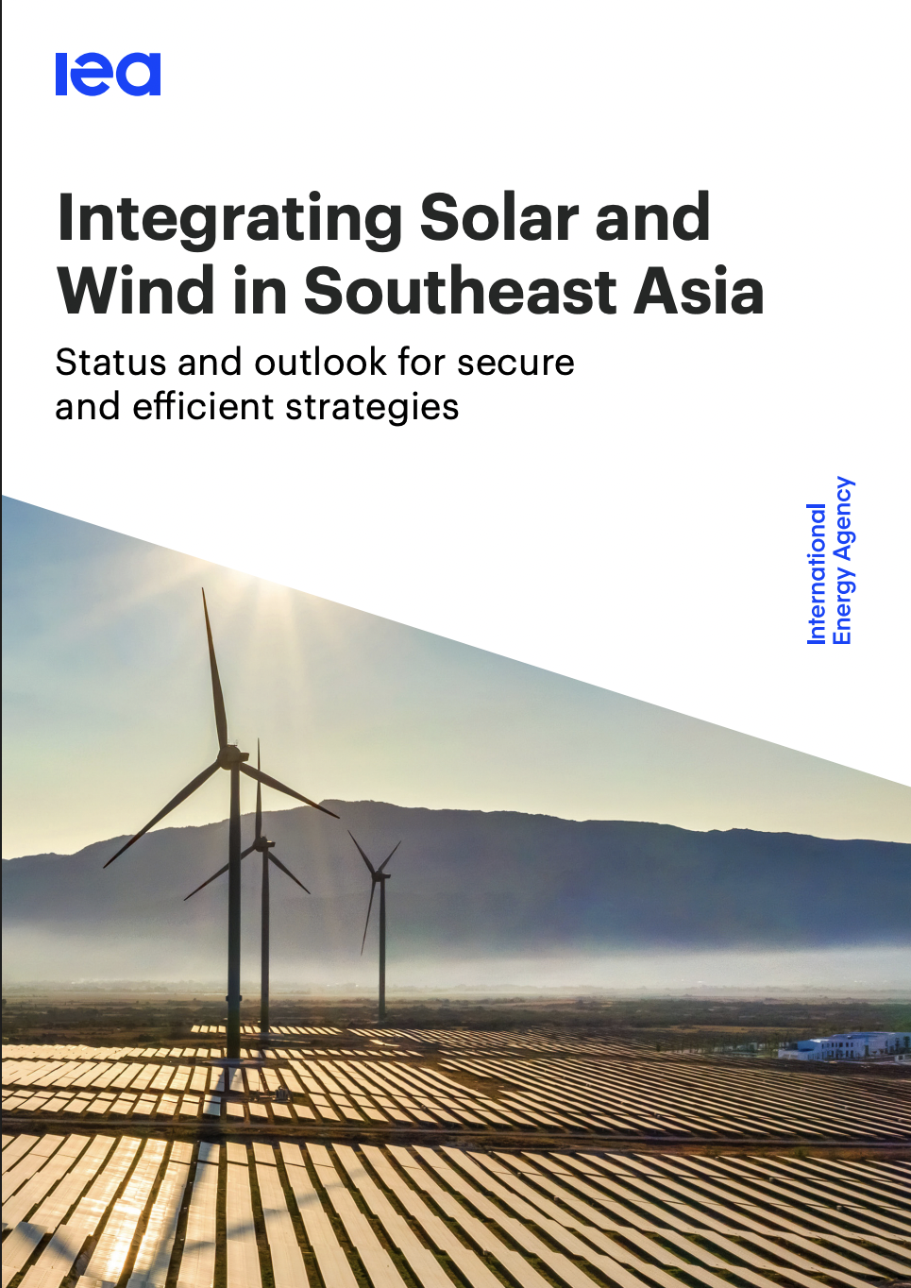
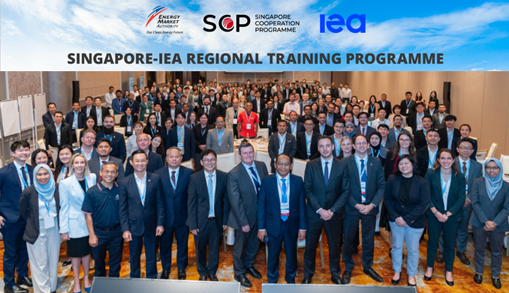
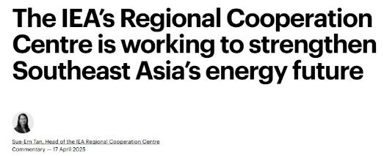
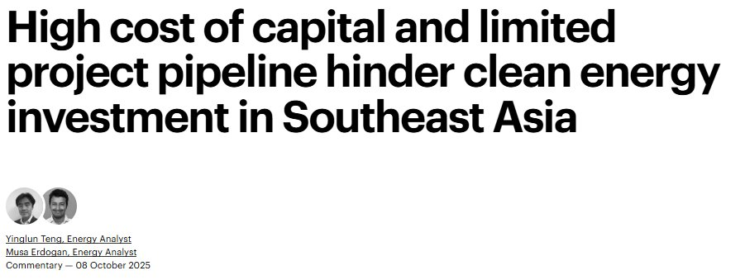
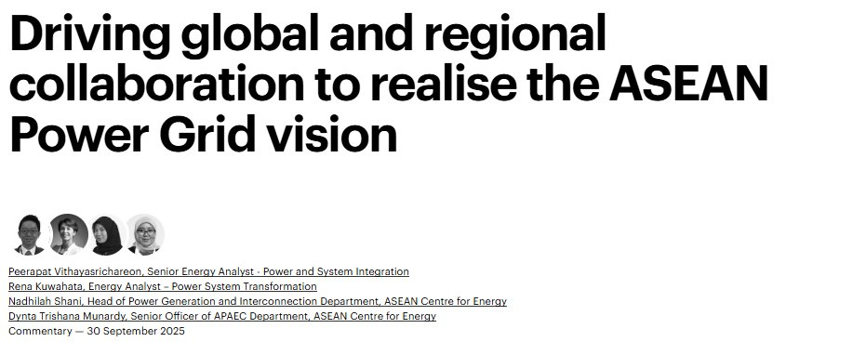
IEA Regional Cooperation Centre delivers data, analysis, capacity building and training
Work in partnership with Southeast Asian governments to advance their energy plans and ambitions

